Slide 1


Ministry of Higher Education and Scientific Research
University of Tunis
National Higher School of Engineering of Tunis
Presented to obtain the National Engineer Diploma in Electrical Engineering
Final Study Project
Demo on New Cryptography Engine For
STM32XX MCU
By Youssef GHRISS
Defended 28/09/2024 before the jury composed of :
Jury president : M. Mourad FATHALLAH
Reporter : M. Maher CHARFI
University supervisor : M. Khalil ABID
Industrial supervisor : M. Nabil JOMAA
Notes:
Hello everyone and welcome. I would like to thank everyone who is here today, and give special regards to the Jury president and reporter and my two supervisors.
I am Youssef Ghriss, and today I will present to you my end of studies project developped within STMicroelectronics entitled « demo on new cryptography engine for stm32xx MCU » Hopefully by the end of this presentation these words will mean more than they do now.

Slide 2
Presentation Plan
1
Project Context
4
Demo Showcase
2
Cryptography Concepts
5
Conclusion and Prospects
3
Cryptography Peripherals
Notes:
So the plan for this presentation is as follows.
We will first introduce the host organization and the project context
Then we will look at x
Followed by y.

Slide 3

Project Context

Slide 4






Project Context 1/7
STMicroelectronics is one of the world’s largest semiconductor companies
Over 50,000 employees of which 9,500+ in R&D
$17.3 billion revenues in 2023
Over 80 sales & marketing offices serving over 200,000 customers across the globe
14 main manufacturing sites
ST is a key player in different sectors such as automotive, industrial and personal electronics
As of December 31, 2023
4
Notes:
STMicroelectronics is the host organization of this project. It is one of the world’s largest semiconductor companies with over bla bla and making over 17 billion dollars in revenues in 2023.
ST is a key player in different sectors such as automotive

Slide 5
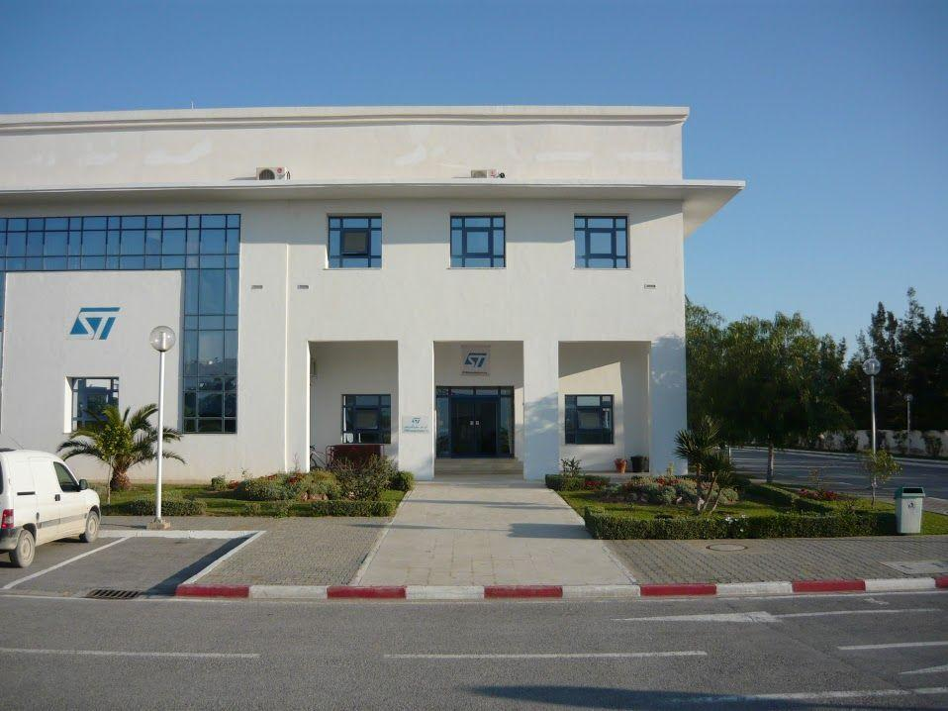
Project Context 2/7
Host Organization
ST Tunis is an R&D site for STMicroelectronics.
ST Support Solutions team handles technical support problems and documentation, as well as helping customers in developping applications on STM32 products.
Notes:
Let’s talk more specifically about ST Tunis which is an R&D site for STMicroelectronics.
This project was developped and conceived by the ST Support Solutions Team

Slide 6
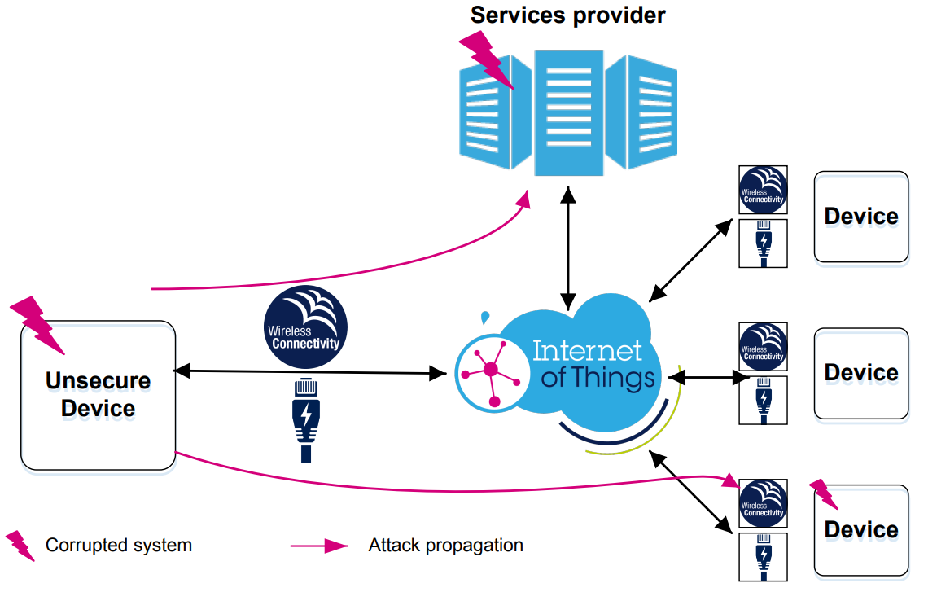
Project Context 3/7
Project Context
With the advent of IoT, embedded devices have become a target for attackers.
Embedded security has become a must-have for modern applications.
Notes:
As Iot devices become more popular, they have become a massive target for cyber attacks. In fact if an attacker manages to get to an unsecure device they might gain access to other devices or potentially even the whole network which would depending on the devices ie medical devices,electric vehicules, cameras and surveillance devices , can lead to devastating damage.

Slide 7
Project Context 4/7
STM32 Cryptography Peripherals
Advanced Encryption Standard (AES)
Public Key Accelerator (PKA)
Secure Advanced Encryption Standard (SAES)
Random Number Generator ( RNG)
Project Context
Cryptography is a major part in ensuring the security of embedded devices.
ST’s product portfolio has a wide range of cryptography peripherals that allow for robust secure solutions.
Notes:
So in this slide , this is what is currently available on the market. These peripehrals are what is available.

Slide 8
Project Context 5/7
Project Context
The Coupling and Chaining Bridge (CCB) is the newest addition to the STM32 cryptography peripherals.
It leverages PKA , SAES and RNG to offer improved security features and ease of use.
The upcoming STM32U3 MCU will be the first product which includes this peripheral.
STM32 Cryptography Peripherals
Advanced Encryption Standard (AES)
Public Key Accelerator (PKA)
Secure Advanced Encryption Standard (SAES)
Random Number Generator ( RNG)
Coupling and Chaining Bridge (CCB)
Notes:
The newest peripheral that has been developped is CCB. It will be relased with the stm32U3 MCU
It is built on top of the PKA SAES and RNG peripherals.

Slide 9
Project Context 6/7
Problem Statement
The complexity of this new peripheral might prove challenging for customers, especially those without a cryptography background.
The new features offered by the CCB need to be clearly showcased to customers.
STM32 Cryptography Peripherals
Advanced Encryption Standard (AES)
Public Key Accelerator (PKA)
Secure Advanced Encryption Standard (SAES)
Random Number Generator ( RNG)
Coupling and Chaining Bridge (CCB)
Notes:
As Iot devices become more popular, devices have become a massive target for cyber attacks. In fact if an attacker manages to get to an unsecure device they might gain access to other devices or potentially even the whole network which would depending on the devices ie medical devices,electric vehicules, cameras and surveillance devices , can lead to devastating damage.

Slide 10


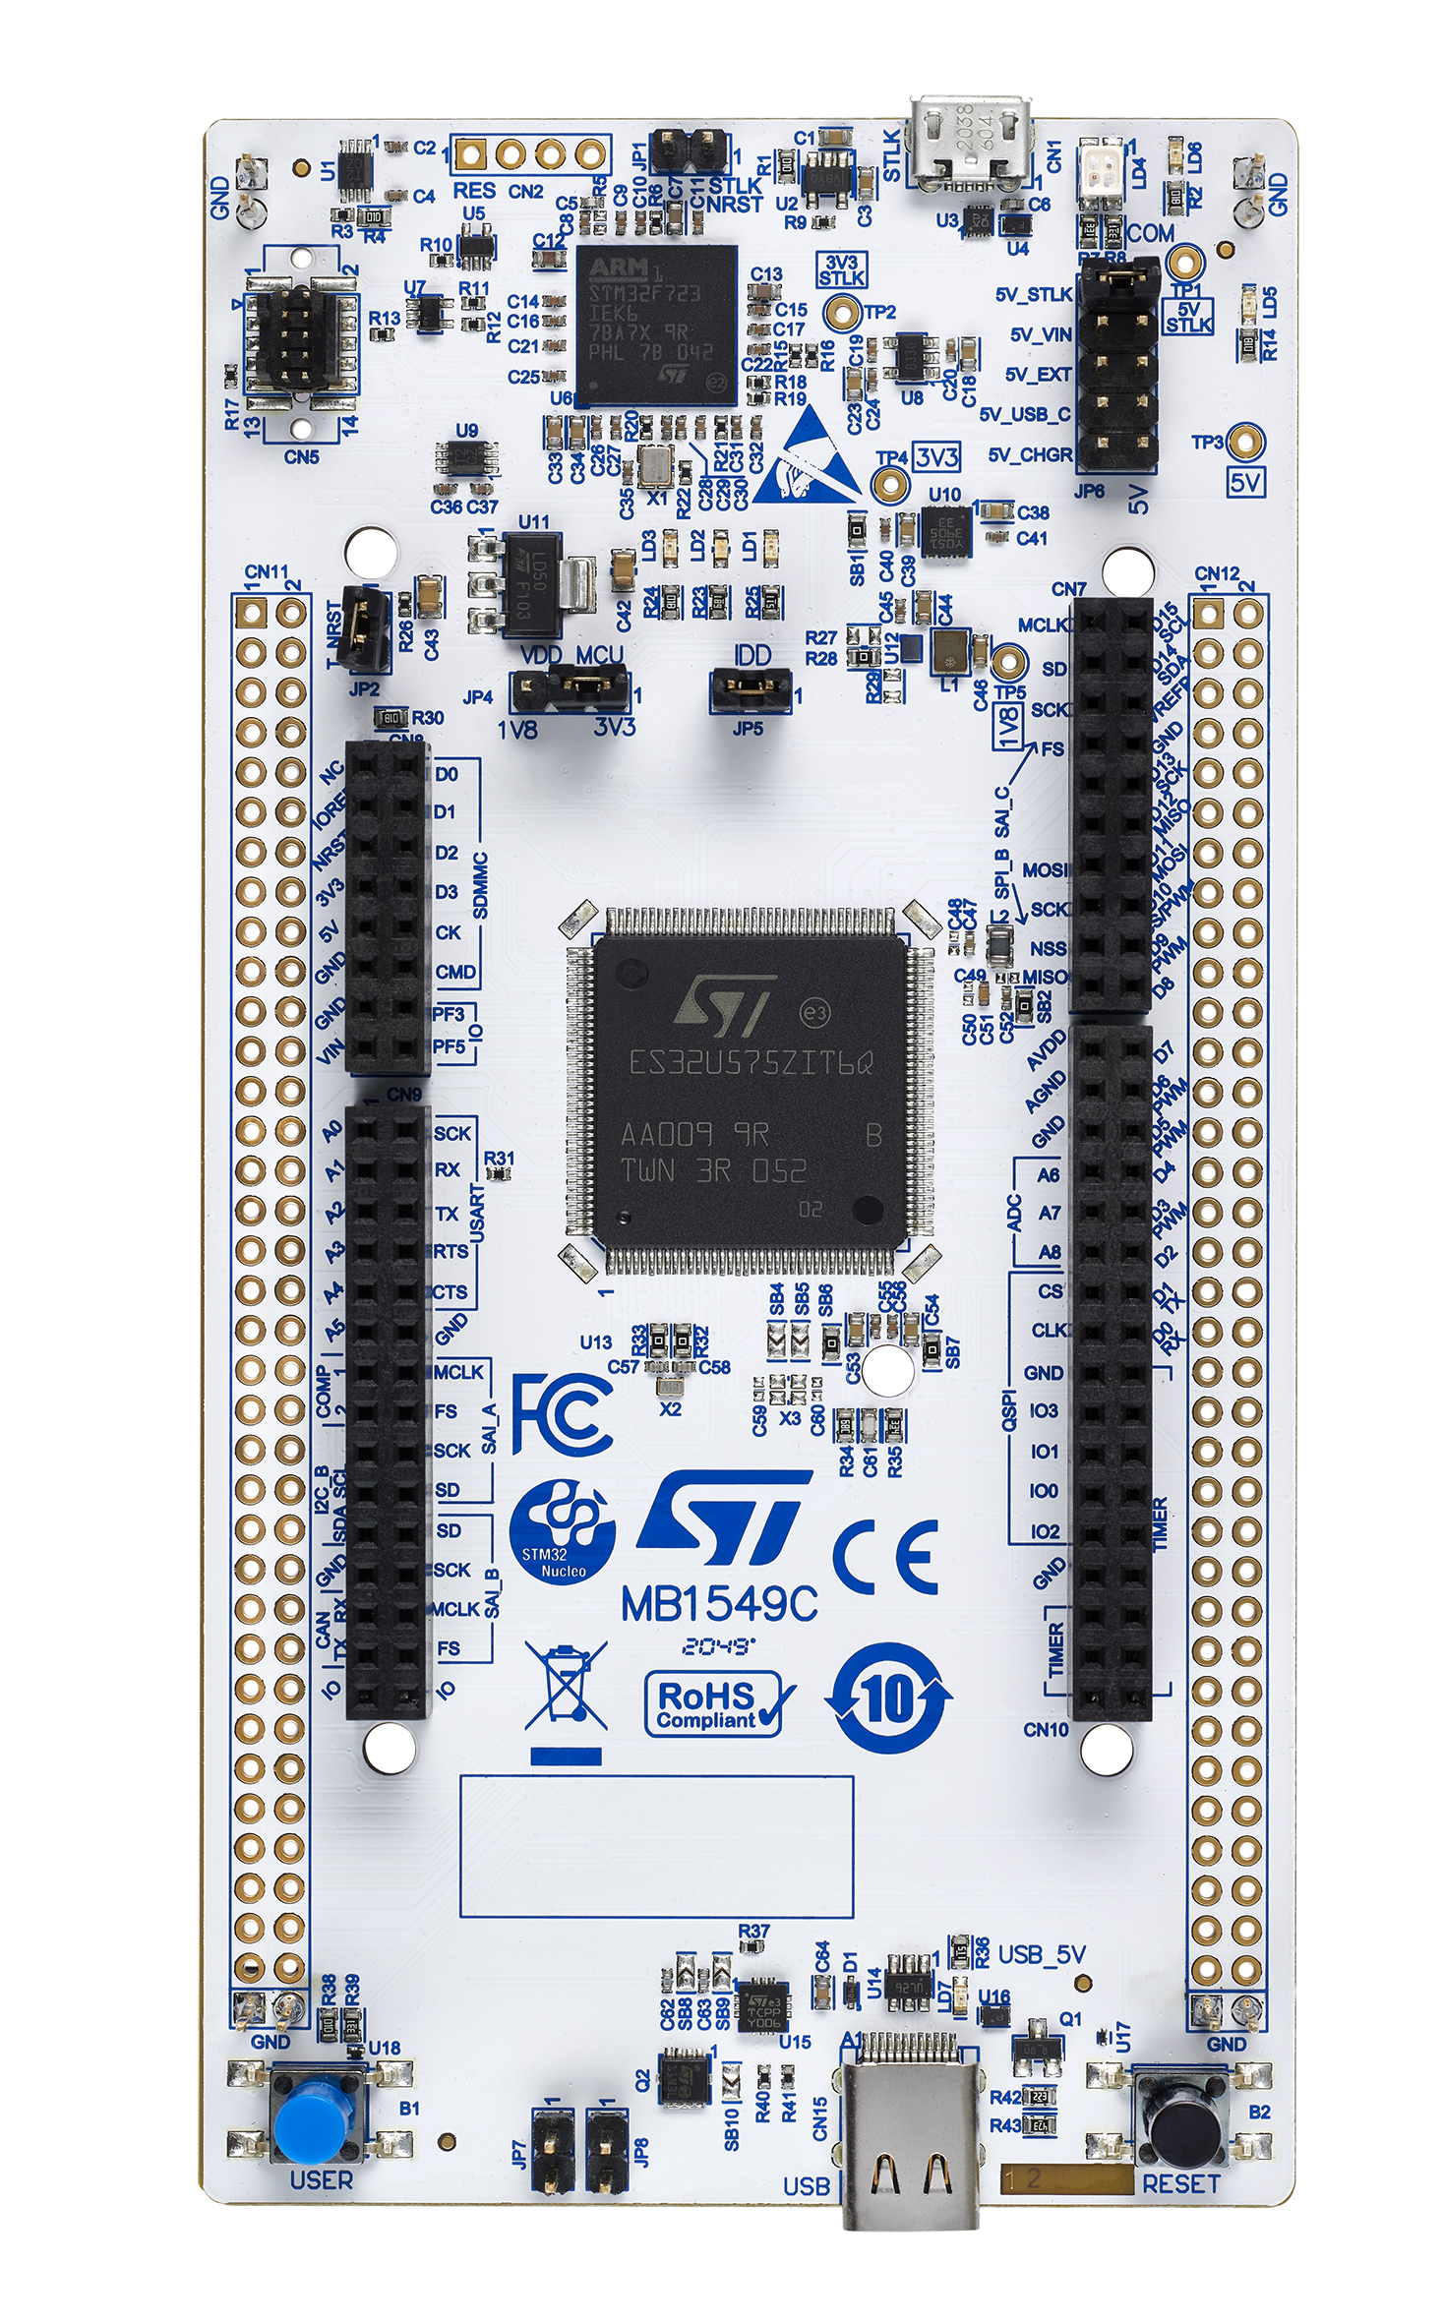

Project Context 7/7
Solution
Develop a demonstration for the CCB which achieves the following objectives :
  Showcase the new features of the CCB compared to currently available peripherals.
  Present a realistic use case of these features.
  Serve as an accessible starting guide for customers hoping to use the CCB.
Secure Communication
Alice Board (U3)
Bob Board (U5)
  ➔ Why use CCB ? And How ?
Notes:
The U3 compared to the U5 you exchange the high performance of the U5 for low power consumption and higher security

Slide 11
Cryptography Concepts

Slide 12
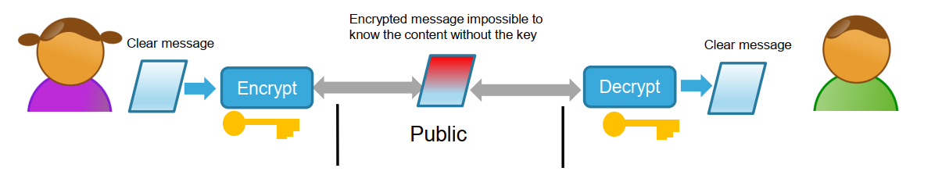
Cryptography Concepts 1/6
Symmetric Cryptography
Algorithm:
AES
In symmetric cryptography, Alice and Bob share the same secret key.
This key is used to both encrypt and decrypt the messages exchanged between them
Advantage: Very efficient.
Drawback: The two parties must somehow exchange the key in a secure way.
Notes:
The U3 compared to the U5 you exchange the high performance of the U5 for low power consumption and higher security

Slide 13
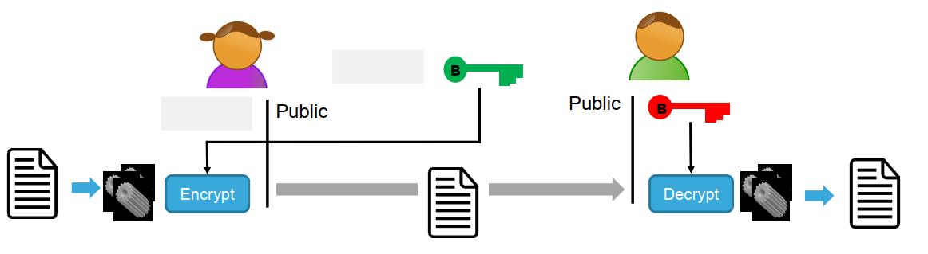
Cryptography Concepts 2/6
Asymmetric Cryptography
Algorithms:
ECC , RSA
In asymmetric cryptography, Alice and Bob each have two keys : a private key and a public key.
Alice must use Bob’s public key to encrypt her message, that way only Bob can decrypt it.
Advantage: Extremely secure.
Drawback: Very resource demanding which makes it impossible to use for large data encryption
Notes:
LANGUAGE METAPHOR.

Slide 14
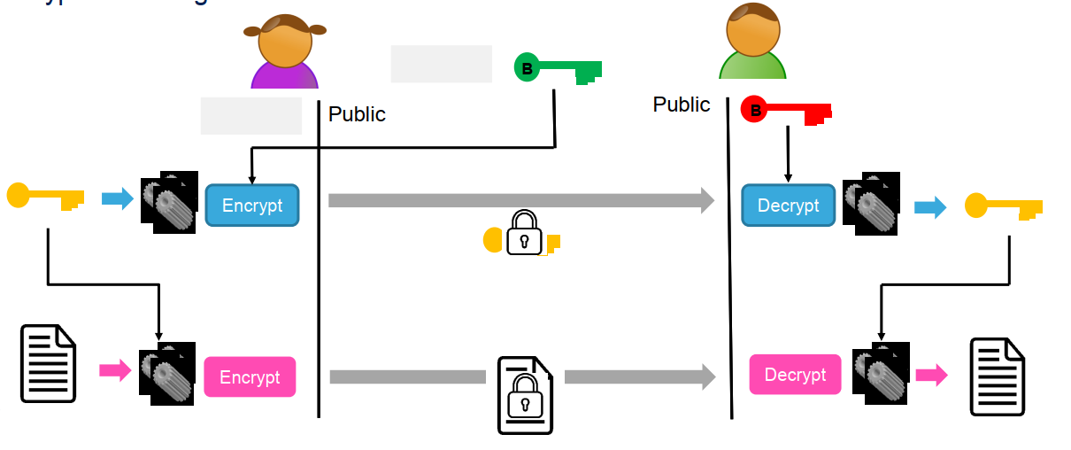
Cryptography Concepts 3/6
Cryptography in Practice: Key Exchange
Algorithm:
ECDH
In practice, we use asymmetric cryptography to securely exchange a symmetric key.
This process is called a Diffie-Hellman Key Exchange, and it is the basis of a secure communication.
Notes:
We use asymmetric cryptography to exchange symmetric keys which are small in size from 128 bits to 256 bits. So we get the security of asymmetric cryptography and the efficiency of symmetric cryptography

Slide 15
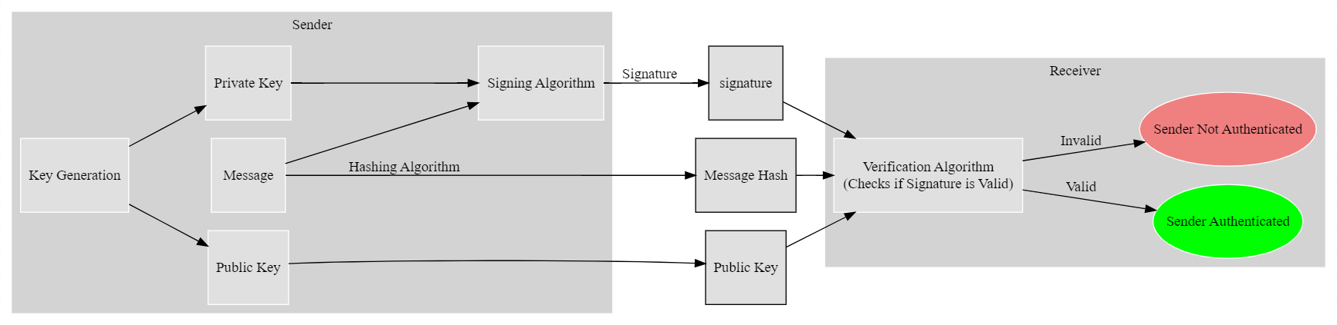
Cryptography Concepts 4/6
Cryptography in Practice: Digital Signatures
Algorithm:
ECDSA
Digital signatures are similar in concept to real world signatures allowing the sender and the receiver to verify each other’s identities.
A digital signature is signed with a sender’s private key and verified with their public key.
Verifying digital signatures is the first step of a secure communication .
Notes:
We see in signature

Slide 16
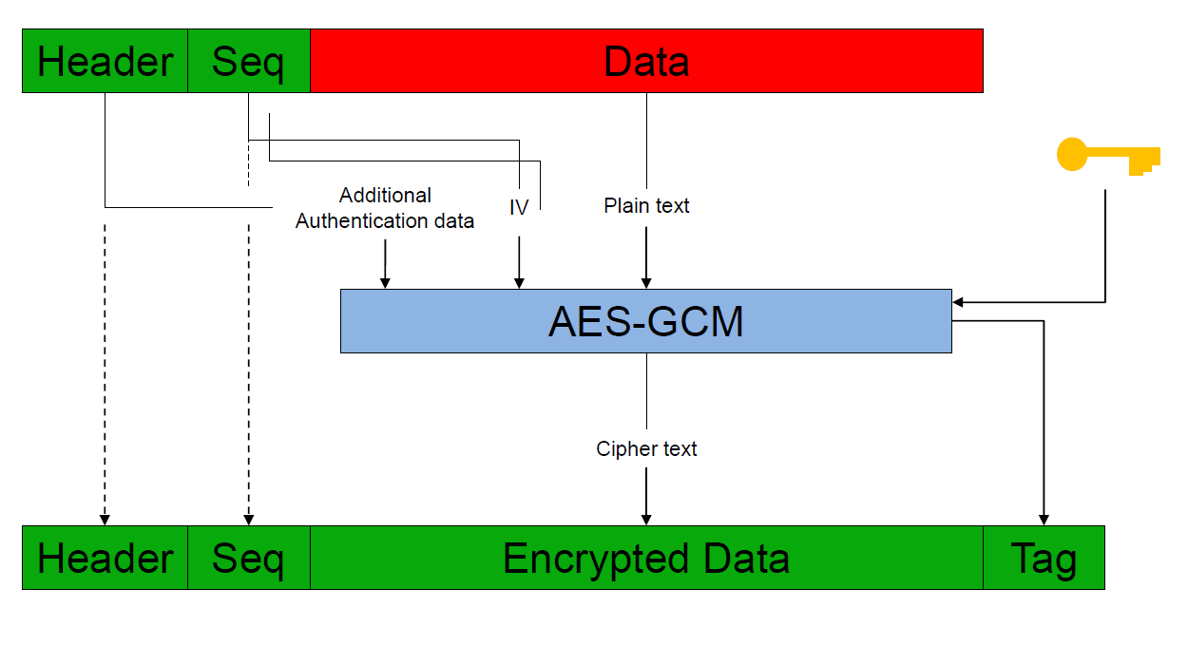
Cryptography Concepts 5/6
Cryptography in Practice: Tag Generation
Algorithm:
AES GCM
(128 bits)
(128 bits)
(128 bits)
During symmetric encryption, we generate an encryption tag that is sent along with the encrypted data.
During symmetric decryption, we generate a decryption tag.
If the two tags match, then we can be sure that the message that we decrypted was truly the message the sender encrypted.
Notes:
We see in signature

Slide 17
Cryptography Concepts 6/6
Cryptography in Practice: Secure Communication
Establishing a secure communication requires applying all the previously shown concepts:
  Digital Signature Verification allows to verify the identity of Alice and Bob (ECDSA).
  Secure Key Exchange sets the stage for symmetric encryption, by generating a symmetric encryption key (ECDH).
  Symmetric Encryption is where the actual exchange of data occurs between Alice and Bob (AES GCM).
  Tag Verification ensures that the decrypted data is truly the original intended data (AES GCM).
Digital Signature Verification
Secure Key Exchange
Symmetric Encryption
Tag Verification
Alice (U3)
Bob (U5)
Notes:
We use asymmetric cryptography to exchange symmetric keys which are small in size from 128 bits to 256 bits. So we get the security of asymmetric cryptography and the efficiency of symmetric cryptography

Slide 18
Cryptography Peripherals

Slide 19
Cryptography Peripherals 1/2
Cryptography Peripherals in current STM32 products
Advanced Encryption Standard (AES)
Used for symmetric encryption and tag generation using AES GCM.
Secure Advanced Encryption Standard (SAES)
A more secure version of the AES peripheral which allows for wrapping symmetric keys with unique hardware keys.
Random Number Generator (RNG)
Public Key Accelerator (PKA)
Generates random numbers essential for many cryptography operations.
Handles all asymmetric cryptography operations (ECDSA, ECDH)
Stores cryptographic data in its own dedicated RAM.
Notes:
We use asymmetric cryptography to exchange symmetric keys which are small in size from 128 bits to 256 bits. So we get the security of asymmetric cryptography and the efficiency of symmetric cryptography

Slide 20
Cryptography Peripherals 2/2
Coupling and Chaining Bridge (CCB):
CCB is an evolution of the Public Key Accelerator, that offers improved security features:
  Wrapping crypto parameters before putting them in PKA RAM, using SAES and a Derived Hardware Unique Key (DHUK) or a user key.
  Enforcing usage of true random numbers using RNG and removing the possibility of using external user generated random numbers , minimizing the security risks that come from bad random number choices.
Randomly Generated Crypto Parameters
Alice (U3)
Bob (U5)
RNG
PKA RAM
CPU
PKA RAM
CPU
SAES
Asymmetric Crypto Parameters
Asymmetric Crypto Parameters
Wrapped Crypto Parameters
Notes:
We use asymmetric cryptography to exchange symmetric keys which are small in size from 128 bits to 256 bits. So we get the security of asymmetric cryptography and the efficiency of symmetric cryptography

Slide 21
Demo Showcase

Slide 22
Conclusion And Prospects

Slide 23
Conclusion
The goal of this project was to create a comprehensive yet accessible guide for customers interested in adopting the new “Coupling and Chaining Bridge” cryptography peripheral developed by STMicroelectronics.
We managed to establish a secure communication line between two STM32 boards, showcasing the new features offered by the CCB peripheral compared to its predecessors.
This was an opportunity to discover and implement modern cryptography techniques on state-of-the-art hardware.

Slide 24
Prospects
Test different types of possible attacks and figure out how the possible vulnerabilities of the CCB peripheral so that they may be improved.
Add more cryptography techniques such as key derivation functions and increase the message transfer size.
Design different use cases for the CCB peripheral aiming for things other than secure communication (secure key management, secure boot, secure firmware update…)

Slide 25
Thank you for your attention

Slide 26
https://securelist.com/iot-threat-report-2023/110644/

Slide 27
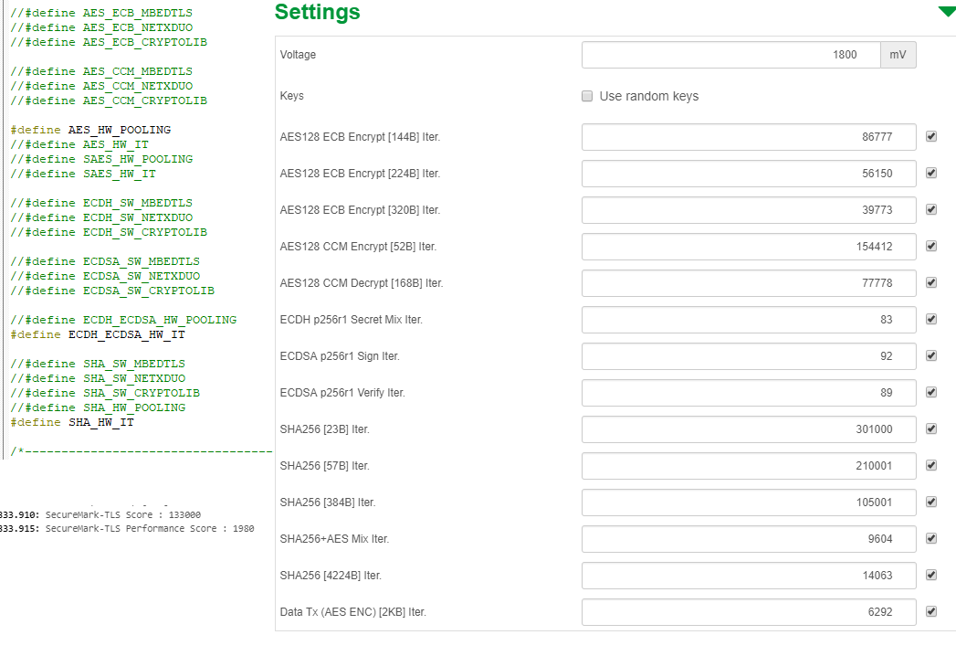
Symmetric vs Asymmetric Speed Comparison
Symmetric
Asymmetric
Notes:
So just for an example on how long Asymmetric operations take compared to symmetric operations
For the securemark ,a benchmark which calculates the energy efficiency and performance of crypto operations,each step takes about 10 seconds.
In 10 seconds,the stm32 board can do 86000 operations of symmetric crypto, for Asymmetric operations, in 10 seconds we can do about 90 operations (for clock speed 24 Mhz for U5 board)

Slide 28
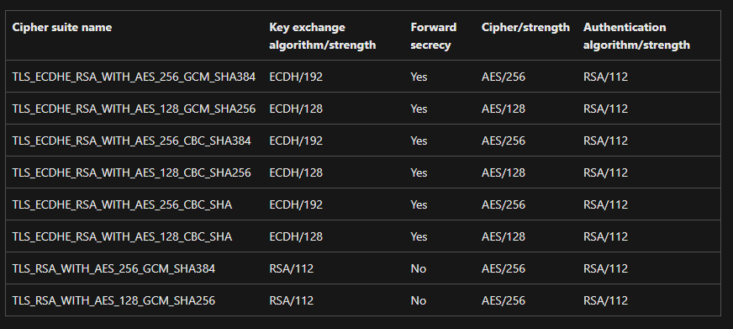
Cipher Suites
Notes:
For people joining us through Microsoft teams, you are listening to me using one of these ciphersuites.
OPEN THE GOOGLE Security THING
and just one detail,the cipher suite used in our small simple demo is actually a bit more secure if we added hashing.

Slide 29
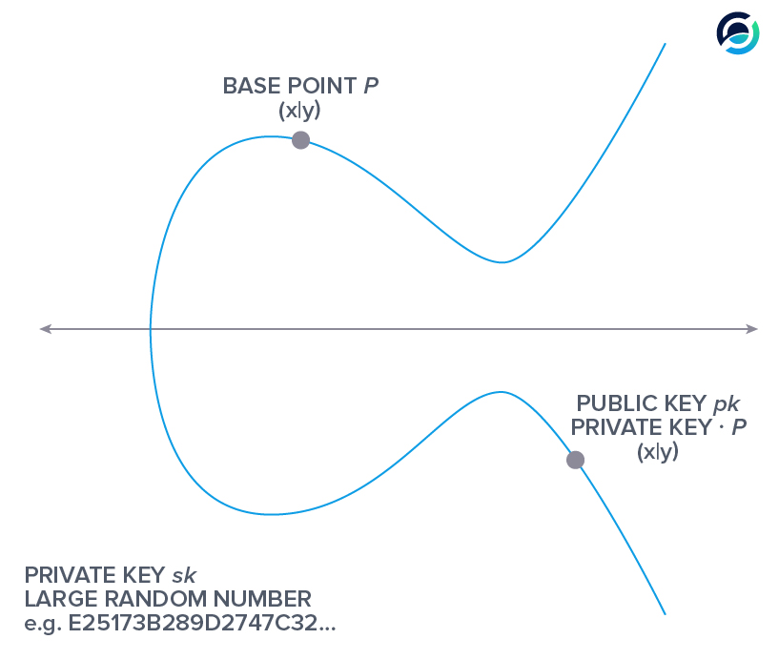
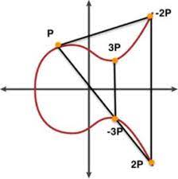
Elliptic Curve Cryptography (ECC)
ECC Scalar Multiplication :
  We draw the tangent of the point we want to multiply
  We find the intersection of this tangent with the elliptic curve
  We find the symmetric of this point which will be on the curve
The complexity of this operation is what makes it very difficult to reverse.
Notes:
This is the elementary building block of all other ECC operations.
So if we understand this we can understand the rest of the oerations.
Animations: lets say im an attacker and I want to find the private key of someone:
I will have their base point P and the public key is P multiplied K times. K is the private key
So you see given these two points.It is almost impossible to find K.The only way is to go through and multiply P by random numbers until we luckily find the correct Public Key.
https://www.desmos.com/calculator/ialhd71we3

Slide 30
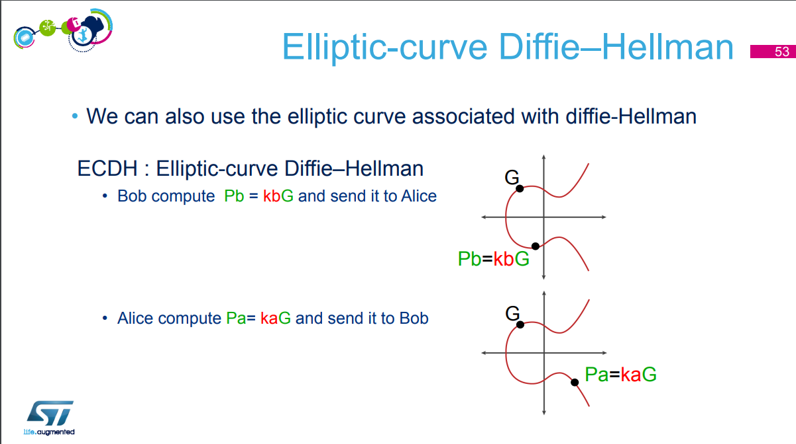
Taken From ST Security MOOC
Notes:
So a Diffie Hellman Shared secret is a method that allows two communicating elements to create a secret variable that only those two parties know
So we both start from the same starting point called generator.This is cgiven by whoever gave you the curve so for this case we are using NIST curve so the G is given by NIST
I calculate my public key by doing my private key by G
(an important point :In ecc the public key is a POINT, the private key is a SCALAR (number)

Slide 31
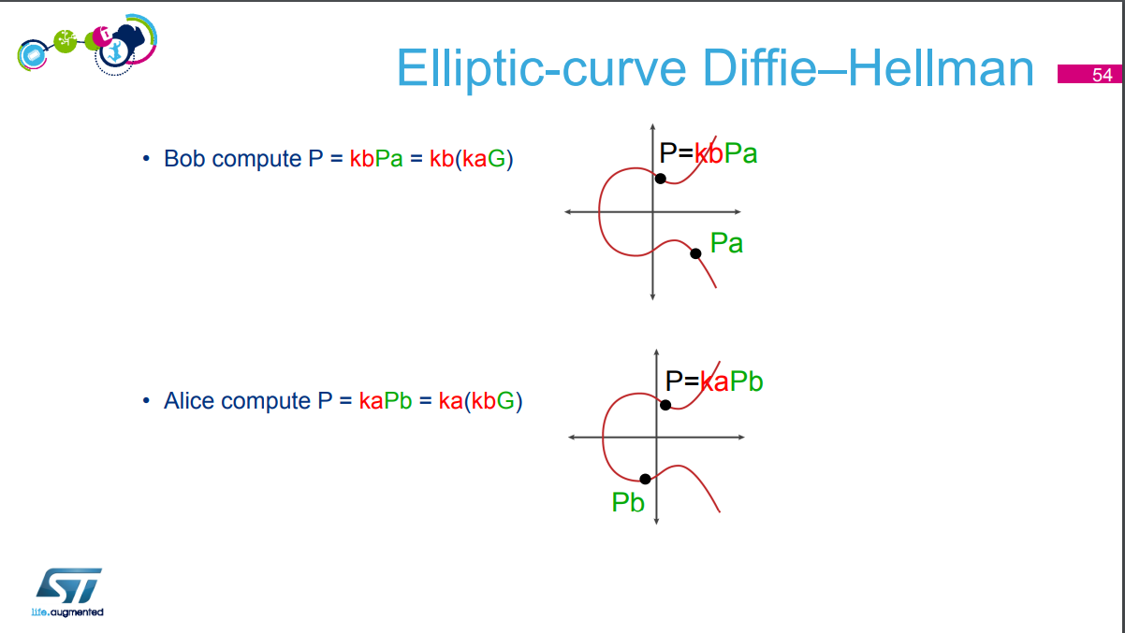
Taken From ST Security MOOC

Slide 32
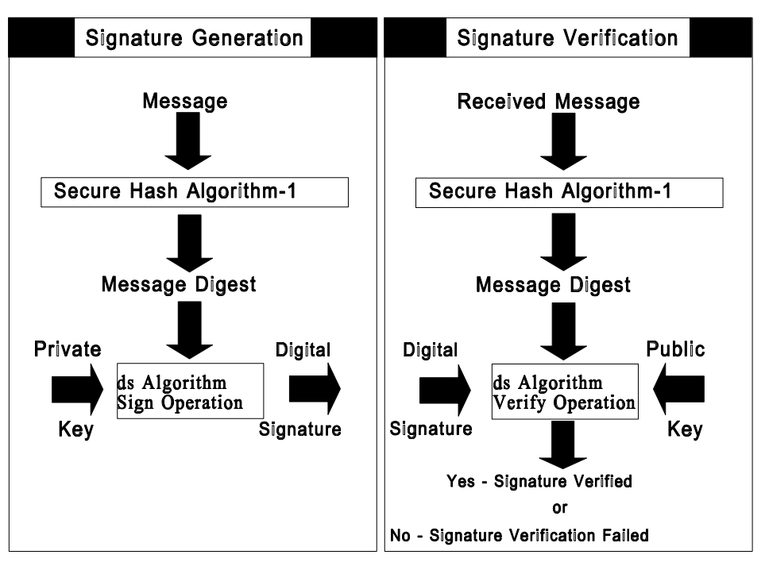
ECDSA Signature
Notes:
Now that we understand elliptic curves , lets see how signatures work
Signature verification is a bit hard to explain without going into the maths too much but just know that the algorithms take care of it and we get a yes or no response either the signature is valid or not.

Slide 33
Wrapping Crypto Parameters (Writing to PKA RAM) using CCB
CPU
Asymmetric Crypto Parameters
PKA RAM
Crypto_param1_address
SAES_DINR
RNG_DR
SAES
Crypto_param2_address
Crypto_param3_address
96-bit Initialization Vector (IV)
AES GCM Encryption = Key + IV
Crypto_param4_address
Crypto_param5_address
Wrapping Key
(Can be DHUK or a user key)
SAES_DOUTR
Readable Cleartext
Readable Encrypted Text
Non-Readable Cleartext
Non-Readable Encrypted Text
Notes:
Note: this is how it is in general for most operations.
However some operations like GenerateWrapKey get the key from RNG instead of CPU
You see that SAES is the interface between PKA and CPU.

Slide 34
CCB/Crypton Description
CCB makes PKA operations more secure using SAES and RNG
But what does “more secure” mean?
The added security provided by the CCB comes mainly from 2 things:
  Wrapping crypto parameters before putting them in PKA RAM, using SAES and a Derived Hardware Unique Key (DHUK) or a user key. (SAES becomes like an interface between PKA RAM and the CPU)
  Enforcing usage of true random numbers using RNG and removing the possibility of using external user generated random numbers , minimizing the security risks that come from bad random number choices.
Notes:
Here we have a part of the description taken from the CCB driver.
We can see there just how connected the PKA operations are to the CCB’s function.
After all it “protects “ PKA operations using SAES. So this is why I wanted to make this presentation to discuss the PKA and SAES first before delving into the CCB itself

Slide 35
Reading/Storing Private Key from PKA RAM using CCB
CPU
AES Encrypted private key is read by CPU and stored in non-volatile memory for future use (Signature/Decryption).
Write 0xCCB
@Asymmetric_Private_key_address
PKA RAM
Crypto_param1_address
Crypto_param2_address
Asymmetric_Private_key_address
Note:
Public params (usually the outputs of PKA) such as signatures and public keys are not encrypted and can be viewed directly in cleartext from PKA RAM.
To read encrypted private key from PKA RAM, we WRITE 0xCCB at the corresponding address.
Crypto_param4_address
Crypto_param5_address
Notes:
Note this does not apply to public values like signatures and generated public keys. Those values are available in cleartext.
To check the integrity of the crypto params, we calculate the tag generated by the encryption . This invloves

Slide 36
CCB Demo Step #1 (Creating/Loading Crypto Parameters)
Alice Board (U3)
Bob Board (U5)
Alice Generates Wrapped ECDSA Private Key (CCB)
Alice Computes ECDSA Public Key (CCB)
Alice uses her private key and a pre-shared hash message to create Alice Signature (CCB)
Bob loads his ECDSA Private Key (generated outside the device)
Bob Computes ECDSA public Key (PKA)
Bob uses his private key and a pre-shared hash message to create Bob Signature (PKA)

Slide 37
CCB Demo Step #2 (Authentication using ECDSA)
Alice Board (U3)
Bob Board (U5)
Alice ECDSA Public Key and Alice Signature (USART)
Bob ECDSA Public Key and Bob Signature (USART)
Both boards use ECDSA verification to verify each other’s signatures
which proves that Alice is really Alice and Bob is really Bob (PKA)

Slide 38
CCB Demo Step #3 (ECDH Key Generation)
Alice Board (U3)
Bob Board (U5)
Alice generates (CCB):
ECDH Private Key
+
ECDH Public Key
Bob loads his ECDH Private Key (generated outside the device)
Bob generates (PKA) his ECDH Public Key
Note: Each of the two boards will have 4 keys total:
ECDSA Key Pair (ECDSA Private + ECDSA Public) for authentication.
ECDH Key Pair (ECDH Private + ECDH Public) for secret generation.

Slide 39
CCB Demo Step #4 (ECDH Exchange)
Alice Board (U3)
Bob Board (U5)
Alice ECDH Public Key (USART)
Bob ECDH Public Key (USART)
Both boards send their ECDH public keys to each other to start secret generation.

Slide 40
CCB Demo Step #5 (ECDH Shared Secret Creation)
Alice Board (U3)
Bob Board (U5)
Alice calculates (CCB):
ECDH =Alice Private Key*Bob Public Key
= Alice Private Key*( Bob Private Key * G )
Bob calculates (PKA):
ECDH =Bob Private Key*Alice Public Key
= Bob Private Key *(Alice Private Key * G )
ECDH Shared Secret → AES Key

Slide 41
CCB Demo Step #6 (AES GCM Encryption)
Alice Board (U3)
Bob Board (U5)
Alice encrypts her message “This is Alice” using ECDH secret as the encryption key and sends it to Bob (AES)
AES Encrypted “This is Alice” + GCM Tag
Bob uses ECDH to decrypt Alice’s message (AES).
If decryption is successful, Bob uses the ECDH to encrypt his message “This is Bob” and sends it to Alice (AES).
AES Encrypted “This is Bob” + GCM Tag
Alice decrypts Bob’s message (AES)
The demo is successful is the received message is decrypted correctly.
Note: AES GCM is the most secure and most used AES mode of operation .It allows for both encryption and authentication.

Slide 42
Alice Board U3 (Send then receive) | Bob Board U5 (Receive then send)
Alice generates Alice Wrapped ECDSA Private Key + Alice ECDSA Public Key + Alice Signature | Bob loads his ECDSA Private Key + ECDH Private Key Bob generates Bob ECDSA Public Key + Bob Signature
Alice sends ECDSA Public Key +Signature to Bob | Bob sends ECDSA Bob Public Key +Signature to Alice
Alice verifies Bob Signature | Bob verifies Alice Signature
Alice generates Wrapped ECDH Private Key + ECDH Public Key | Bob loads his ECDH Private Key and generates his ECDH Public Key
Alice sends her ECDH Public Key to Bob | Bob sends his ECDH Public Key to Alice
Alice uses Protected ECC Multiplication to create ECDH Shared Secret | Bob uses unprotected ECC Multiplication to create ECDH Shared Secret
Alice uses ECDH Shared Secret as source of AES GCM key and IV | Alice uses ECDH Shared Secret as source of AES GCM key and IV
Alice sends encrypted “This is Alice” message + Tag to Bob | Bob sends encrypted “This is Bob” message + Tag to Alice
CCB
PKA
USART
USART
PKA
PKA
CCB
PKA
USART
USART
CCB
PKA
AES/SAES
AES
USART
Notes:
A great detail about this is the signatures are unique everytime and the private and public keys will be unique and regenerated after Every Reset which is great
Even google for example keeps the same ecdsa key for 2 weeks before needing to change,in your application you can have your crypto parameters change as often as you want

